Slide 1
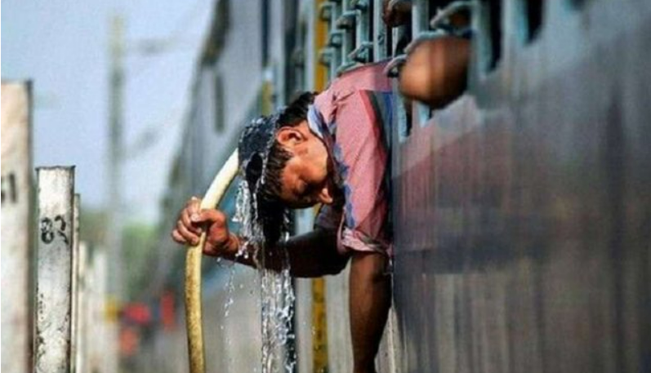
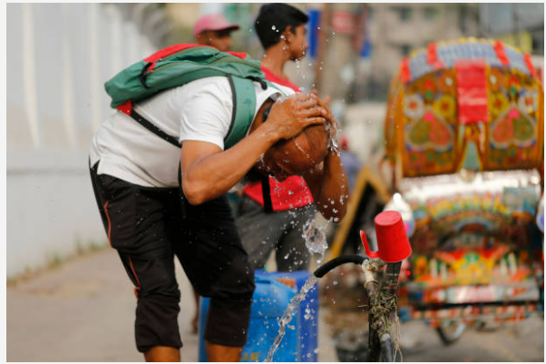
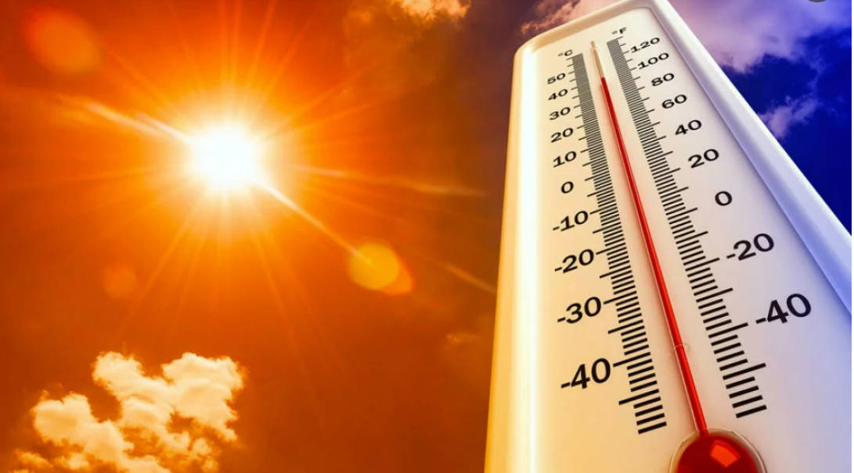
Spatio-temporal variation of Land Surface Temperature and their relationship with multispectral indices in Dhaka city
https://steemit.com/reason/@hiderwqa/what-is-the-reason-for-the-sudde-temperature-in-dhakan-increase-in
https://www.gettyimages.in/photos/hot-weather-in-bangladesh
https://www.dhakatribune.com/bangladesh/324561/bangladesh-sweats-under-high-temperatures
Contributors: Sourav Karmakar, Sourav Dey, Fahima Begum, Asif Raihan
Presenter : Sourav Karmakar

Slide 2
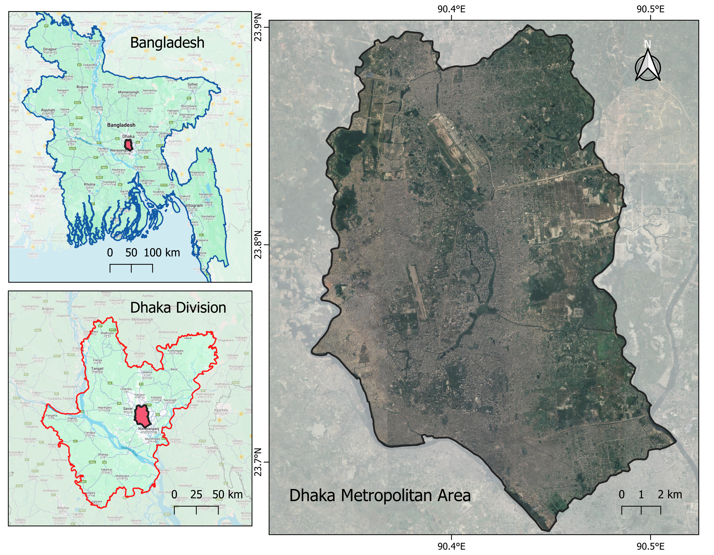
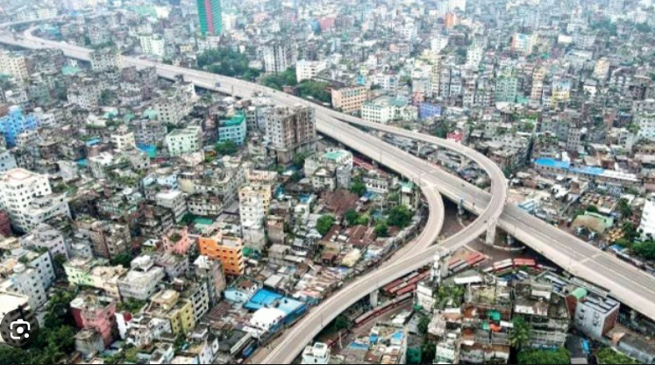
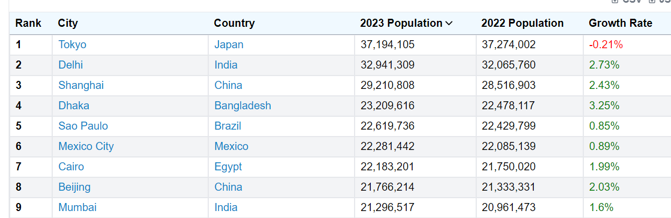
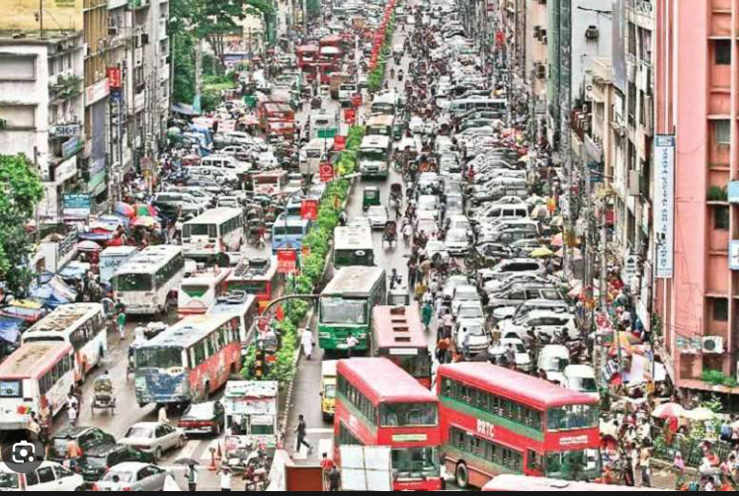
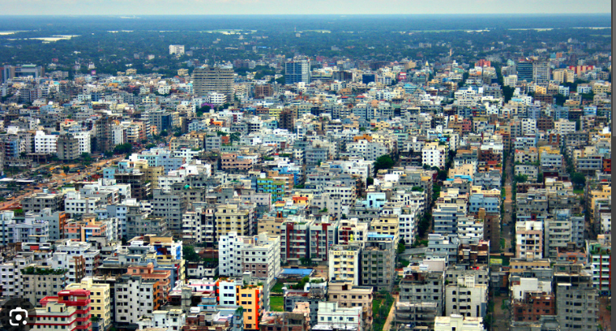
DHAKA
https://worldpopulationreview.com/world-cities
Area: 304.16 km2
Population: 23 millions
Density: 23,234/km2
Temperature: 40.7 °C, 2023 highest in the last 54 years
Rainfall: 2000 mm/yr

Slide 3
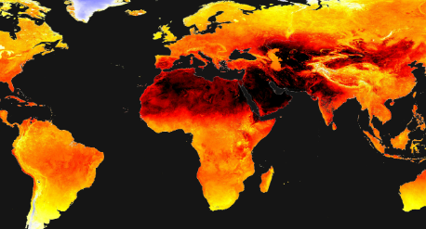
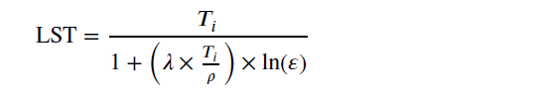
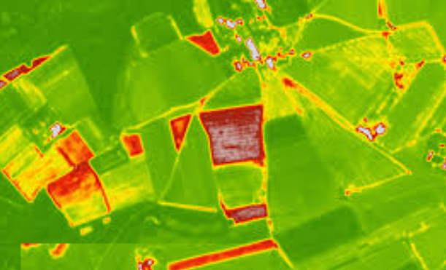
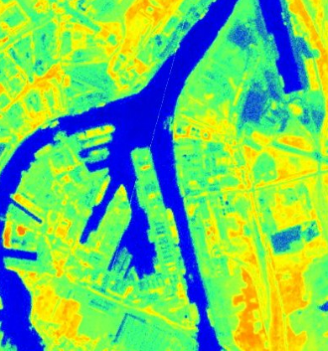
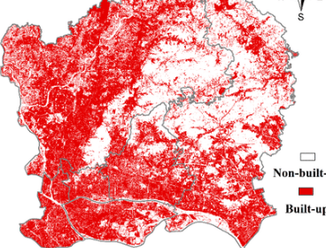
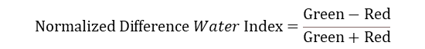

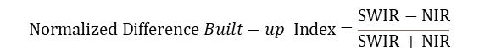
Objectives:
Spatiotemporal variation of Land Surface Temperature from 2015 to 2021
Land Surface Temperature
Correlation with multispectral indices (NDVI, NDWI, NDBI)
𝑇_{𝑖} = brightness temperature of the sensor, 𝜆 = wavelength of the emitted radiance, Ɛ =spectral emissivity of the land surface
$$Normalized Difference Vegetation Index =\frac{NIR−Red}{NIR+Red}$$
$$Normalized Difference Water Index=\frac{Green−Red}{Green+Red}$$
$$Normalized Difference Built−up Index=\frac{SWIR−NIR}{SWIR+NIR}$$

Slide 4
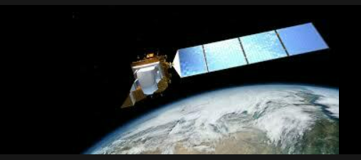
Landsat image achieve
Landsat 8 (2013 to present)
Methods
Study area extraction
Filter date & Cloud cover
2015, 2018, 2021
March to August
<5% cloud cover
Create Median Composite
3-5 images / year
LST
NDVI
NDWI
NDBI
Sample raster points
Correlation Analysis

Slide 5
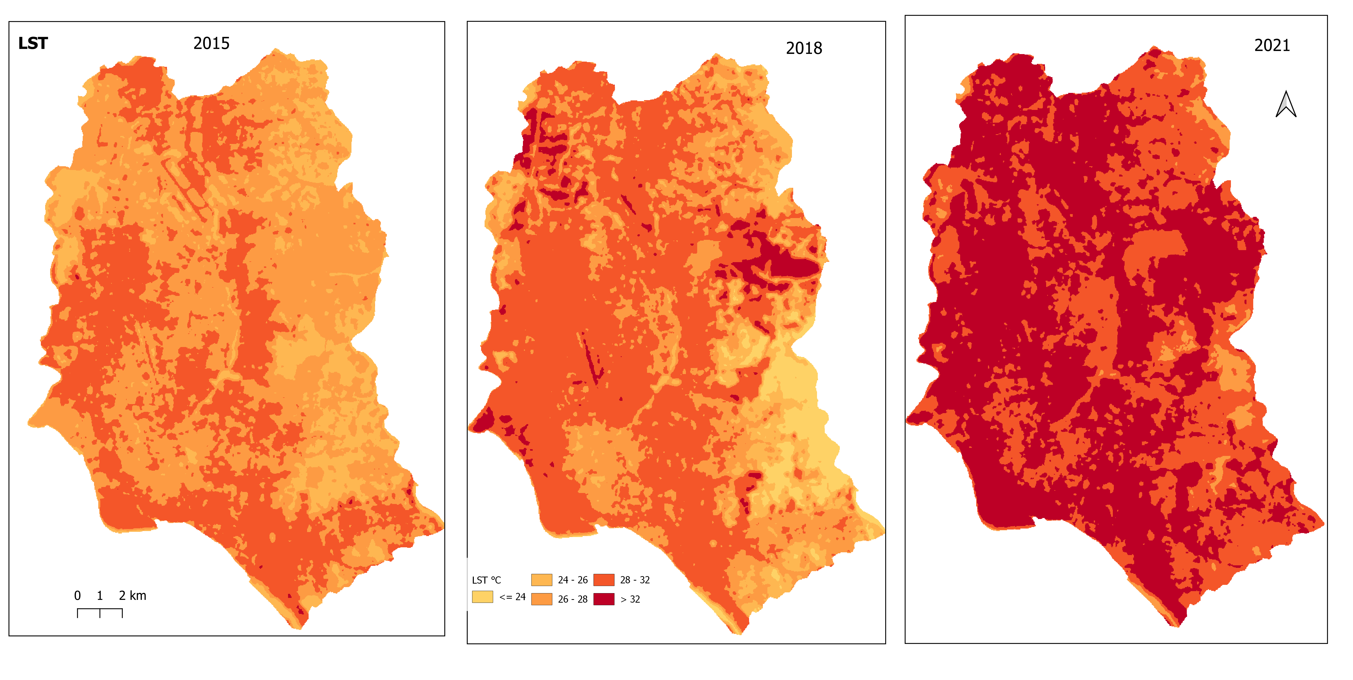
Results

Slide 6
Results

Slide 7
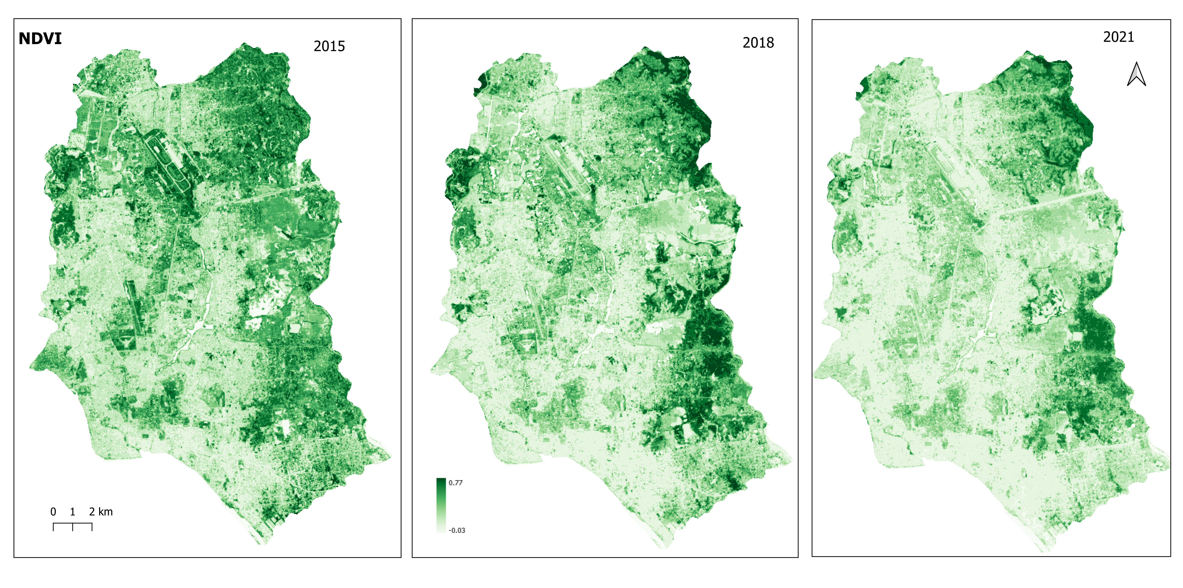
Results

Slide 8
Results

Slide 9
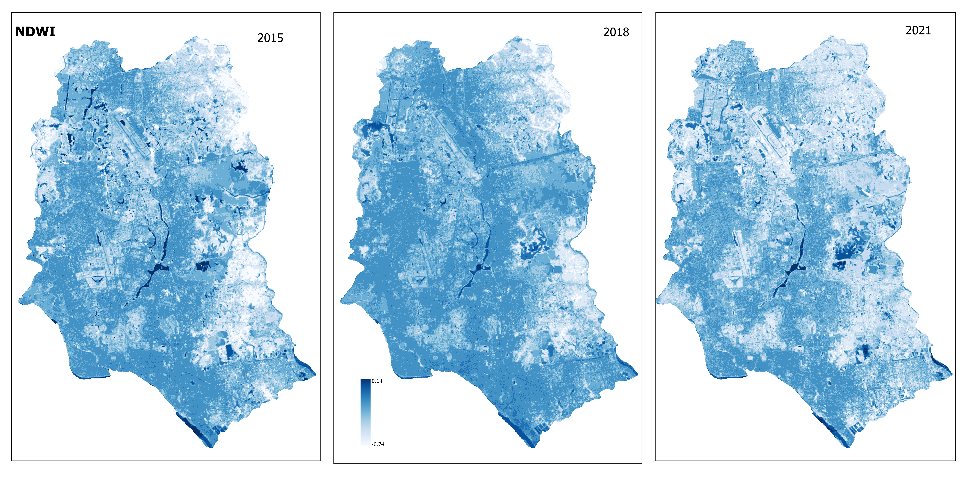
Results

Slide 10
Results

Slide 11
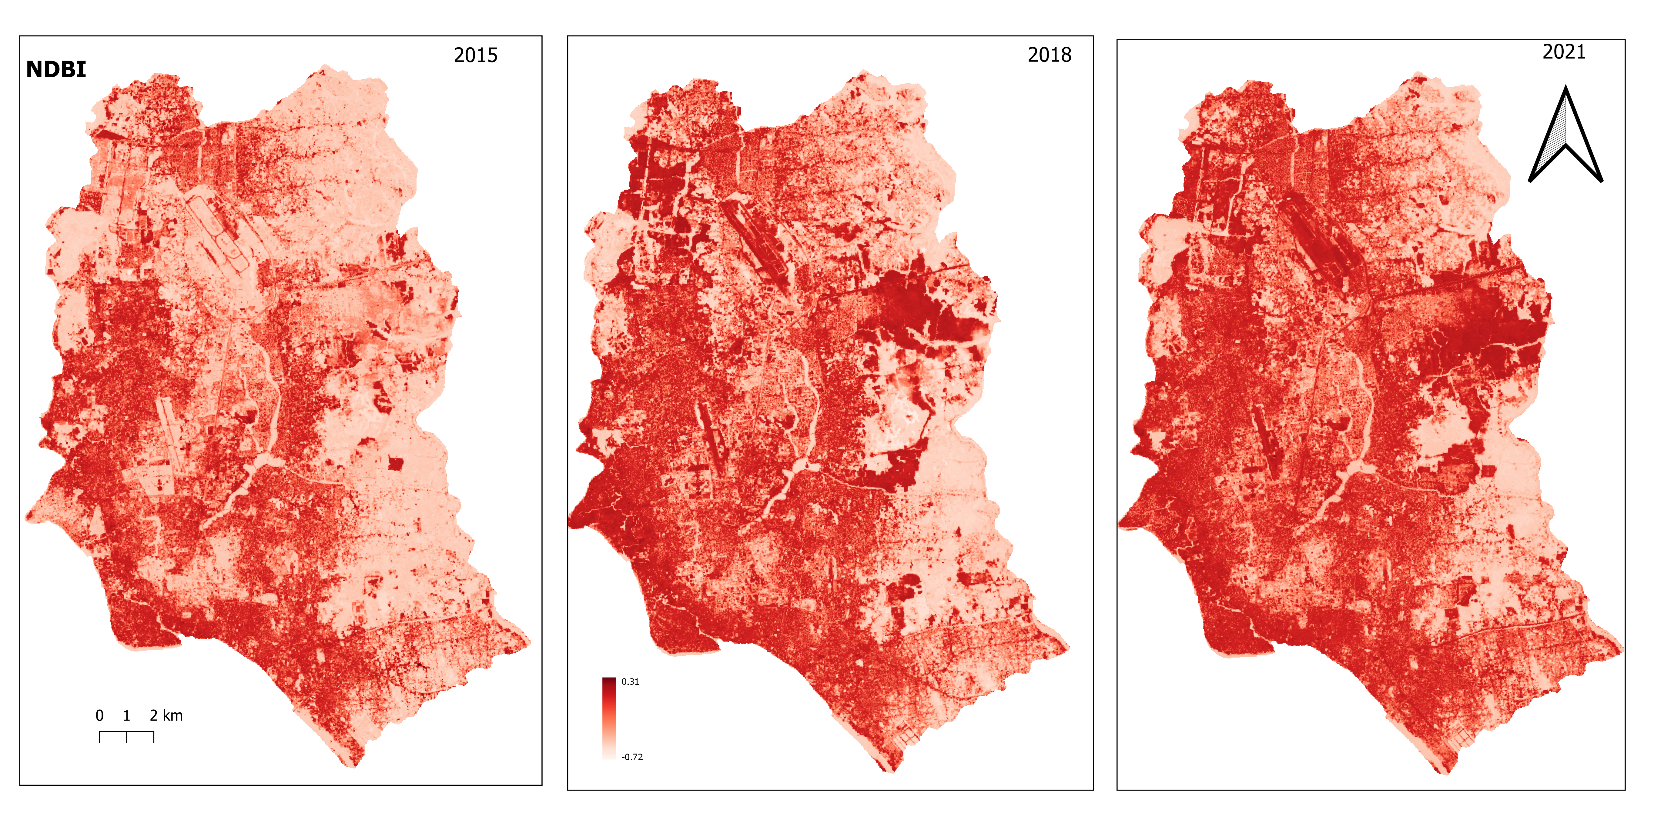
Results

Slide 12
Results

Slide 13
Results

Slide 14
Results

Slide 15
Results

Slide 16
Findings
From 2015-2021 period, +58% of the DMP areas experienced higher temperature
NDVI & NDWI declines, while NDBI increased
Strong correlation (R2=0.57 to 0.61 )has been found with NDBI
Weakest correlation with NDWI (0.07-0.14)
Moderate correlation with NDVI (0.29-0.31)

Slide 17
Recommendations
Green urban space should be increased (Rooftop plantation, roadside plantation could be key)
Sustainable management of urban water bodies (Also need for fire protection)
Synchronized urban planning among departments
Policy formulation/modification for controlling urban buildings

Slide 18


Thanks for your patience ….

